Slide 1
CMND Installation, Configuration and Use Westan Australia
Updated: 26/03/19 CB Location: Dropbox\Knowledge Base\Training\CMND Filename: CMND – Installation, Configuration and Use

Slide 2
Goals & Assumptions
Goals
Show how to perform a new CMND installation (if CMND server not already supplied
Show how to connect a Philips hotel TV to CMND over IP
Give overview of various areas of CMND
(more detailed/advanced operations can be found in CMND user guides)
Assumption:
TVs are xxHFLx014 (signage models not covered here).
TVs and CMND server are networked and within same subnet
No PMS integration covered
CMND v7.x.x is used

Slide 3
Training Overview
Preparation: Download the latest SW version (if required)
Installing CMND (if required)
Using CMND
- Connect TV to CMND over IP
- Upload and modify a clone file, including
Editing settings
Assigning channel packages
Assigning content
- Push out a clone file to TVs

Slide 4
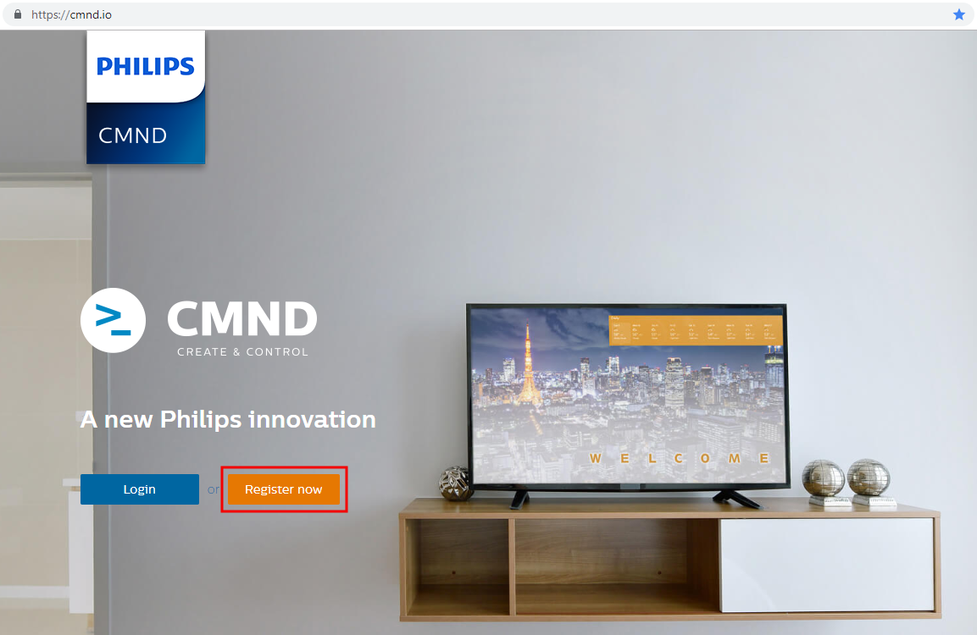
Download latest software version
You can find the CMND Server software, manuals and other related information on the CMND Create & Control website: https://cmnd.io
New users will need to register for access. Account approvals can take up to 48 hours

Slide 5
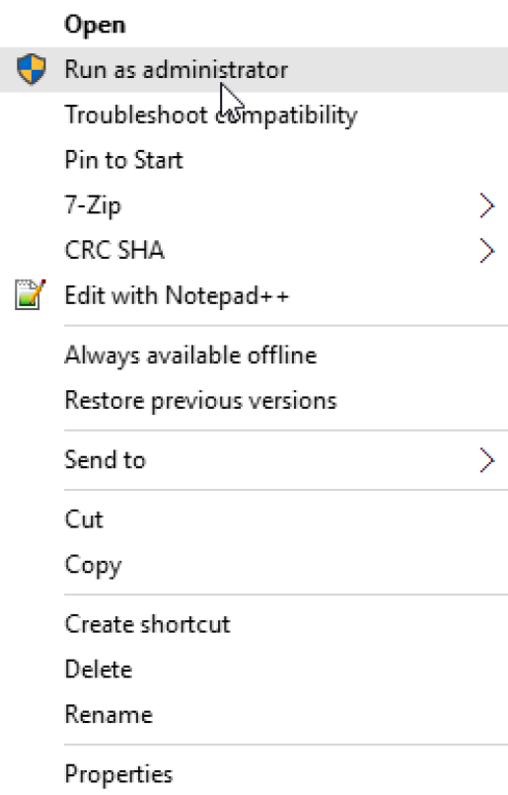
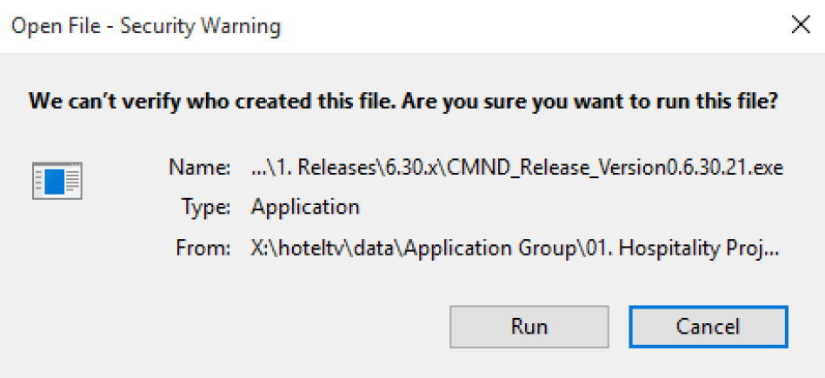
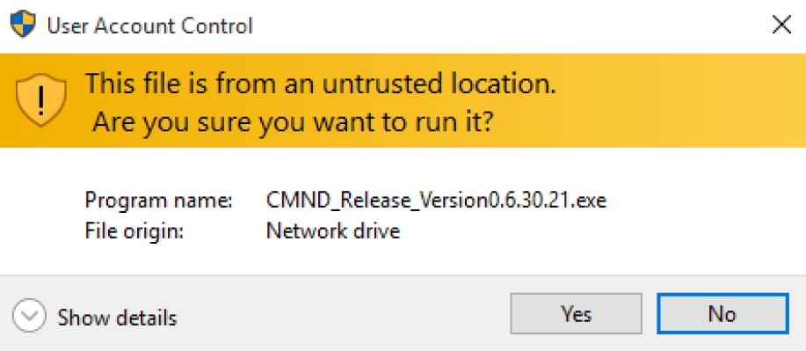
Installing CMND
After downloading the latest version from the cmnd.io website, locate the executable in your downloads folder, right click and Run as administrator
Approve any Windows popup messages to continue the installation

Slide 6
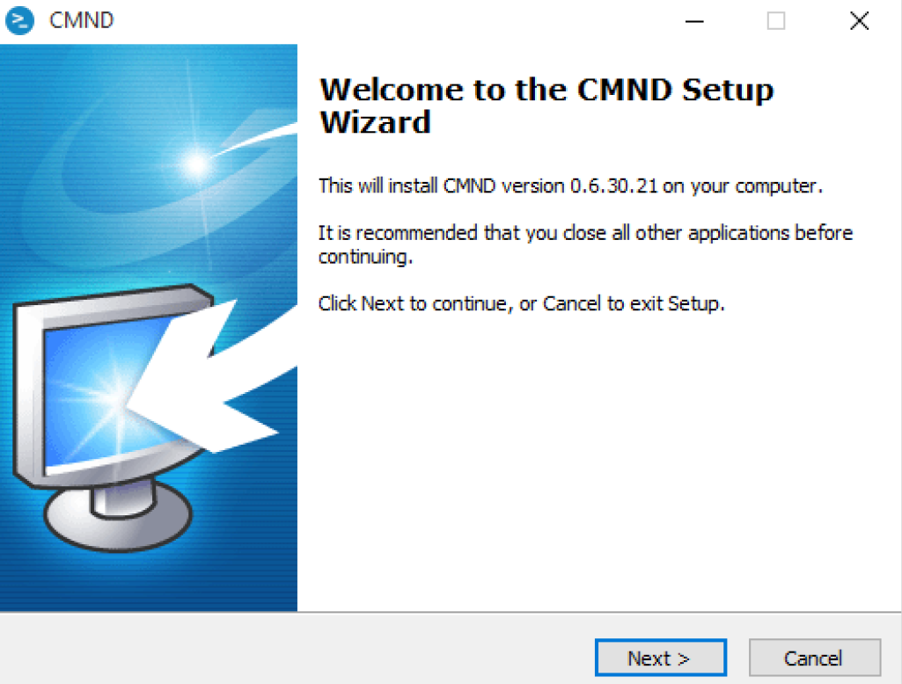
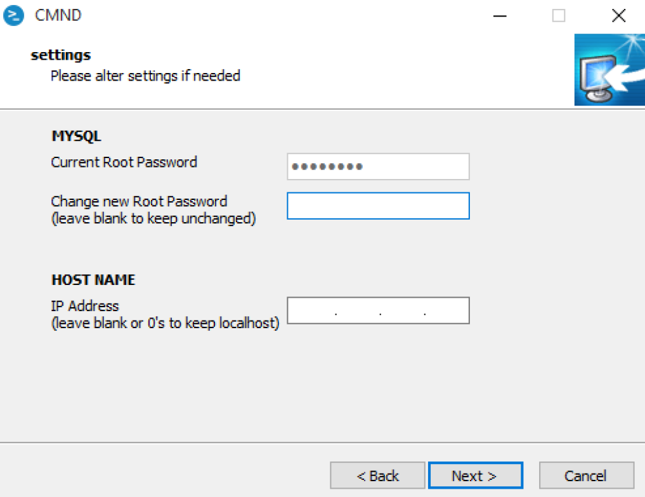
Installing CMND
After the Welcome screen you can configure some details:
MYSQL – if this is the first installation, choose a password. If you are upgrading, this field will be prefilled and there is no need to change.
HOST NAME – to install CMND as a localhost application (only accessible from the PC you installed on) leave this blank. To have CMND accessible from another PC in the same network, enter the actual IP address of the PC you are installing on.
It is recommended to set a STATIC IP address for CMND

Slide 7
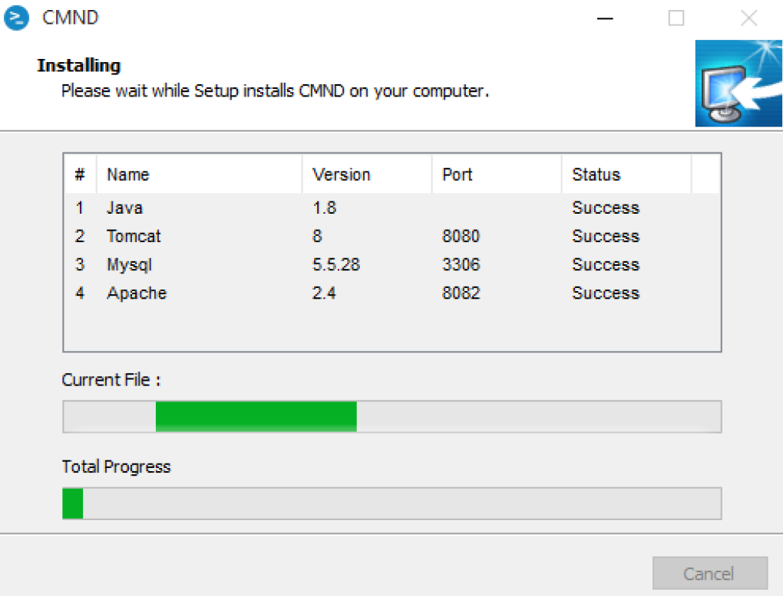
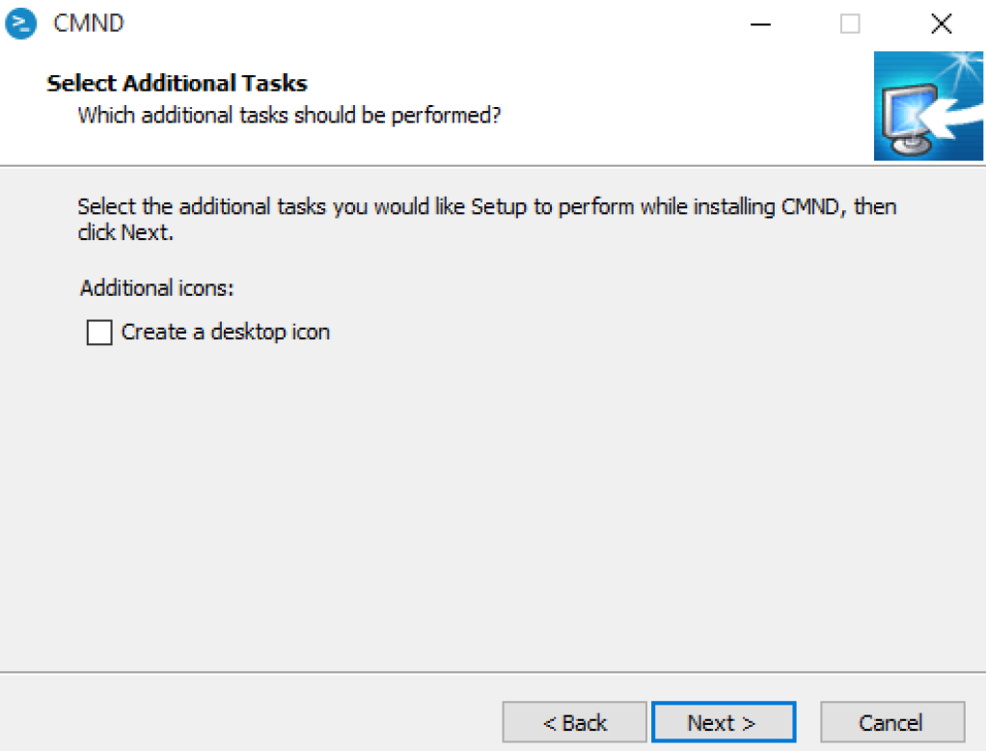
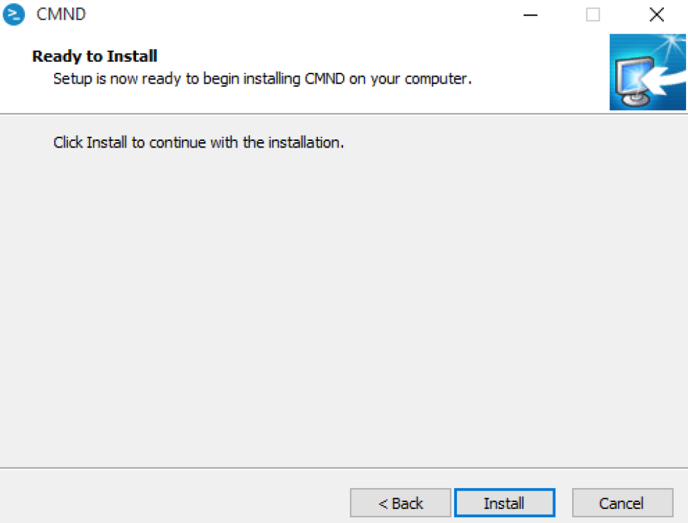
Installing CMND
Choose to add a desktop icon, confirm the installation and wait while all CMND prerequisites are installed if not available

Slide 8
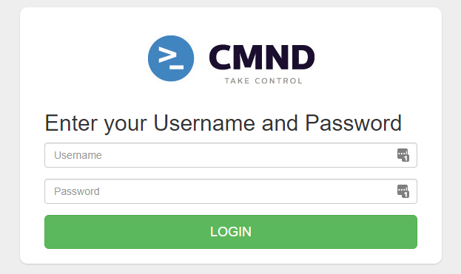
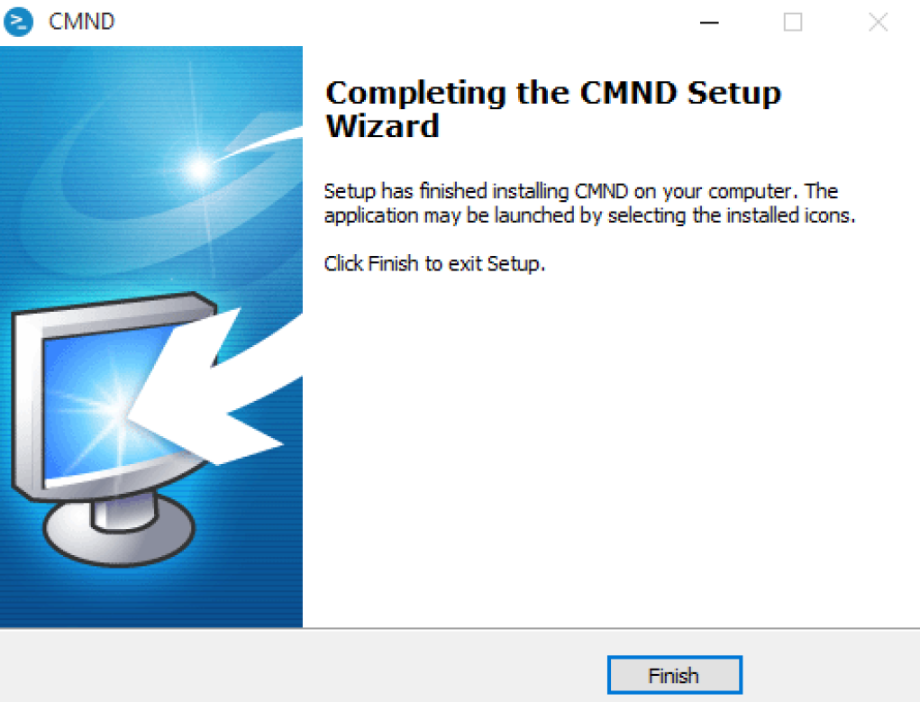
Installing CMND
After successful installation you will see the following screen.
Clicking “Finish will close the installer and open CMND on your default browser (preferably Chrome)

Slide 9
Using CMND
When launching CMND, your default browser will open to the login page.
Default credentials:
User: admin
Password: tpvision
You will need to choose a new secure password after logging in for the first time

Slide 10
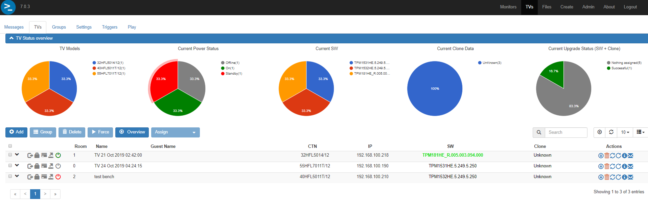
Using CMND
After logging into CMND you will be presented with the default CMND screen.
The main areas relevant to management of hotel TVs are:
TVs – monitoring/management of TV network
Files – management of files (software, clones, apps, etc)
Create – Content creation and editing

Slide 11
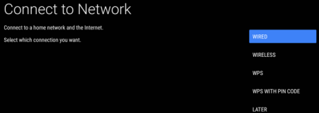
Using CMND – Connect TV to CMND over IP
To add TVs to the TV list in CMND, ensure the following configuration steps have been completed on the TV
Connect the TV to the local network
Navigate to [Wireless and Networks] -> [Connect to Network]

Slide 12
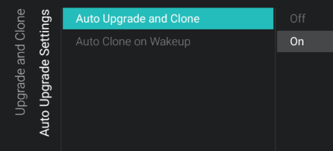
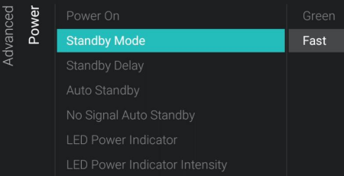
Using CMND – Connect TV to CMND over IP
Navigate to [Upgrade and Clone] -> [Auto Upgrade and Clone]
Set to [ON]
Navigate to [Advanced] -> [Power]
[Standby Mode] set to [FAST]

Slide 13
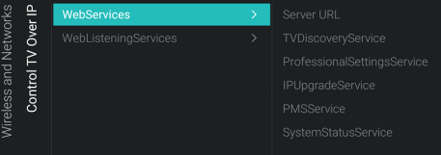
Usign CMND – Connect TV to CMND over IP
[TVDiscoveryService] set to [ON]
[ProfessionalSettingService] set to [ON]
[IPUpgradeService] set to [ON]
[PMSService] set to [ON]

Slide 14
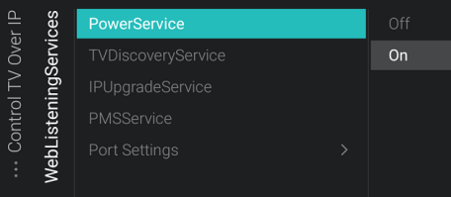
Using CMND – Connect TV to CMND over IP
Navigate to [WEBListeningServices]
[PowerService] set to [ON]
[TVDiscoveryService] set to [ON]
[IPUpgradeService] set to [ON]
[PMSService] set to [ON]

Slide 15
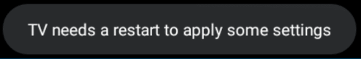
Using CMND – Connect TV to CMND over IP
Press [BACK] on remote control until you exit the professional menu.
TV should prompt you to restart to apply settings
Power down and restart TV

Slide 16
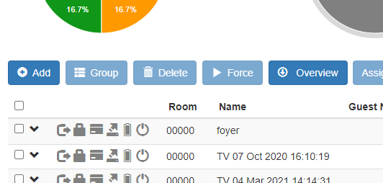
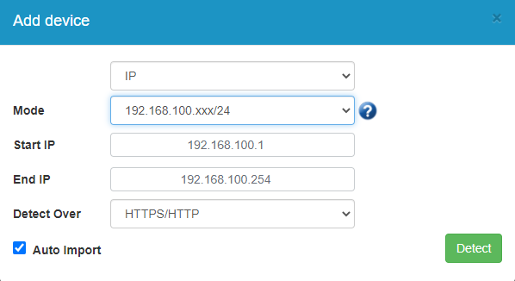
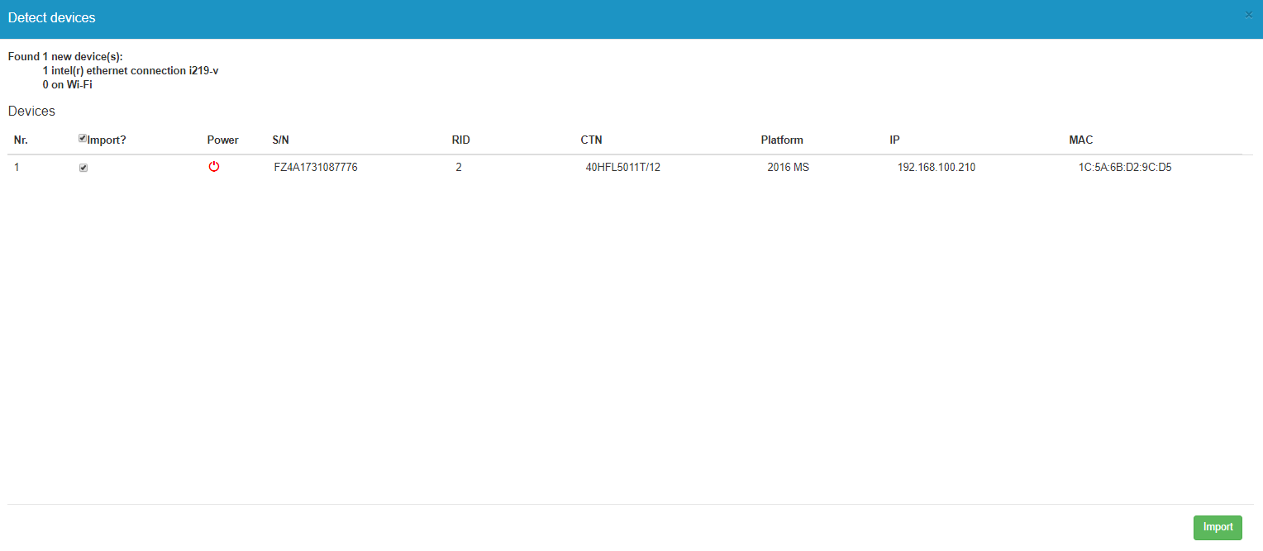
Using CMND – Connect TV to CMND over IP
Select Add button on [TVs] tab
Select local network interface
in Mode field
Check/uncheck Auto Import
Select Detect
(if Auto Import left unchecked)
List of un-added TVs will be shown which can be Imported into the CMND TVs list

Slide 17

Using CMND – Connect TV to CMND over IP
Network status overview
Power Status
Room ID
TV Name
Model
IP address
Software version
Clone version

Slide 18
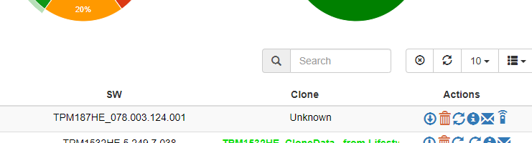
Using CMND – Upload and modify a clone file
Import clone from a TV over IP

Slide 19
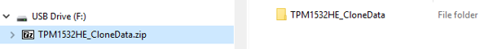
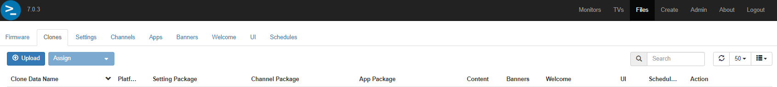
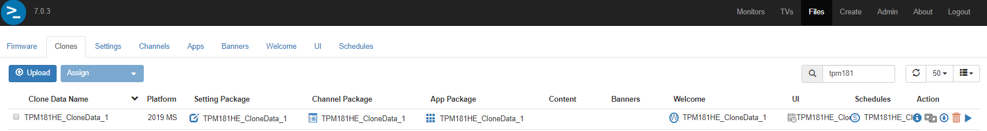
Using CMND – Upload and modify a clone file
Import clone from USB
First ZIP the entire clone folder that has been downloaded from a configured TV (process not covered here)
Select the [Files] tab
Select the [Upload] button and choose the zipped clone folder
New uploaded clone file will be uploaded to CMND and is listed in the Clones List
Clone files can be renamed

Slide 20
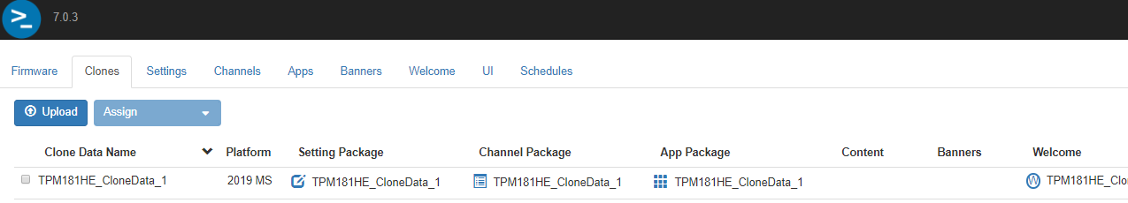
Using CMND – Upload and modify a clone
Clone files that are uploaded are divided into several parts, including:
Setting Package
Channel Package
App Package
Content

Slide 21
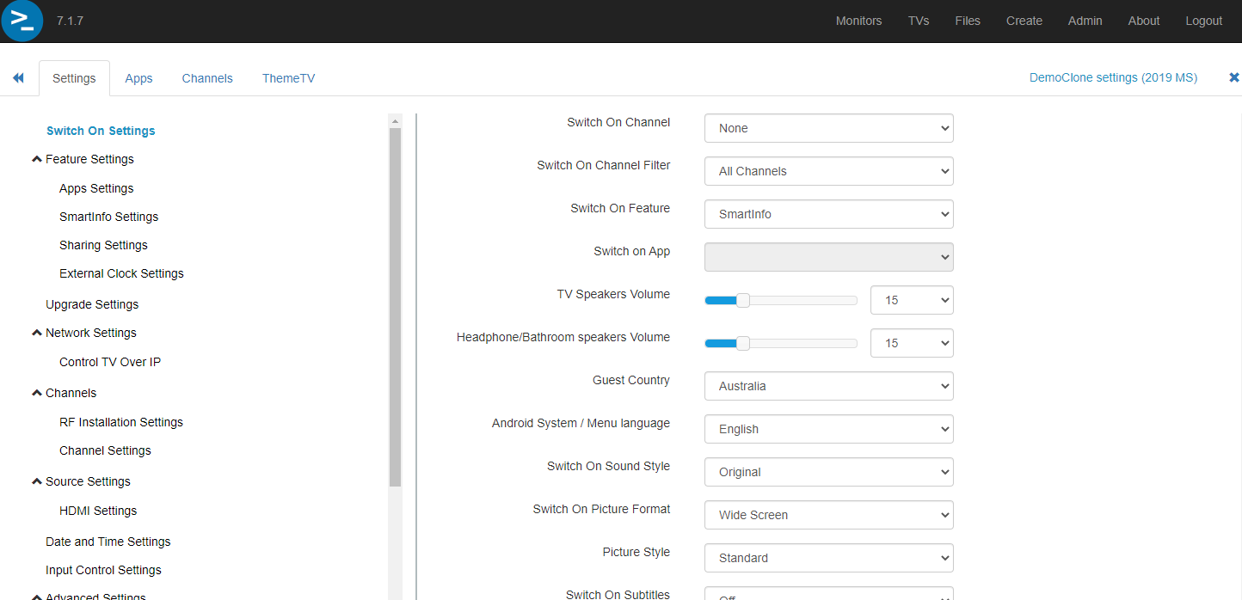
Using CMND - Upload and modify a clone file
To edit settings of a clone:
Select the Settings icon in the clone list
The settings are grouped in the same way you would find them in the Pro Menu on the TV
Any changes made will be automatically saved
The name of the settings file you are editing is printed at the top of the page.

Slide 22
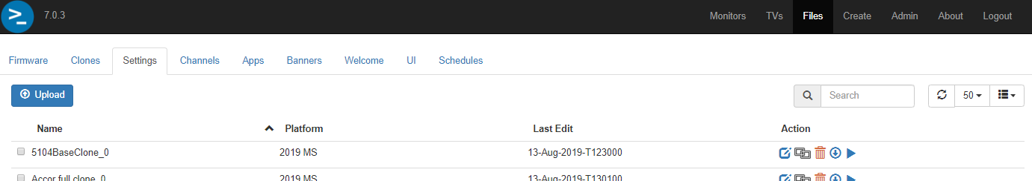
Using CMND – Upload and modify a clone
Settings Packages
You can also view all settings packages that have been created when uploading a new clone
Go to Settings tab
To edit a settings package, select the Settings icon
Can also rename a package from here

Slide 23
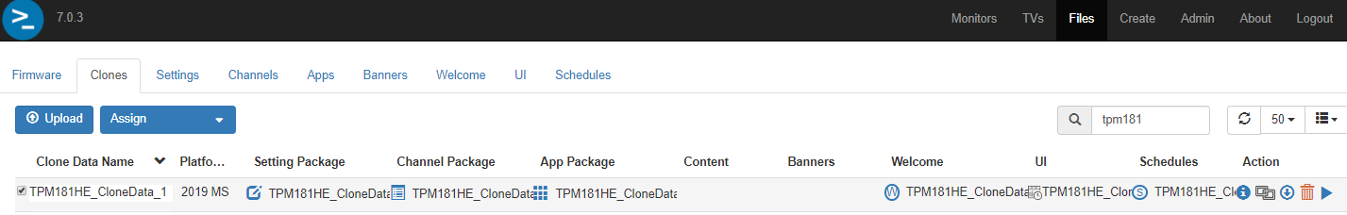
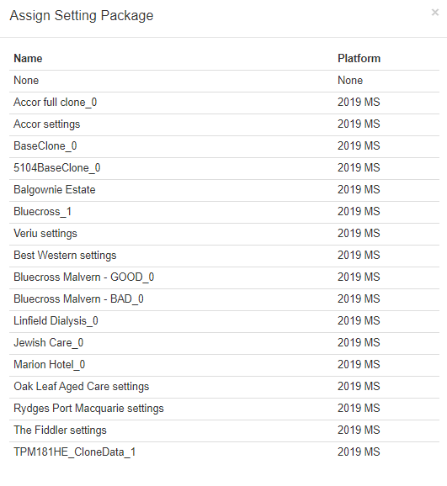
Using CMND – Upload and modify a clone
To assign a new Settings package to a clone
Select the checkbox next to the clone
Select “Assign” button, then Settings
Choose the desired settings package from the popup list
Packages can only be assigned to a clone file which is based on the same platform the original package was created from

Slide 24
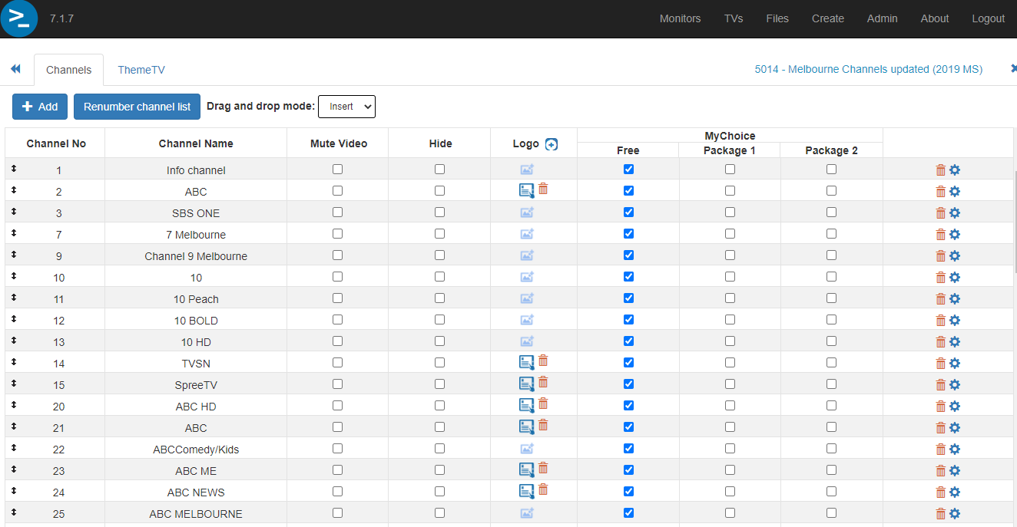
Using CMND - Upload and modify a clone file
To edit channels of a clone:
Select the Channels icon in the clone list
Reorder/renumber Channel No
Rename Channel name
Mute video or hide a channel from the TV list entirely
Delete channels

Slide 25
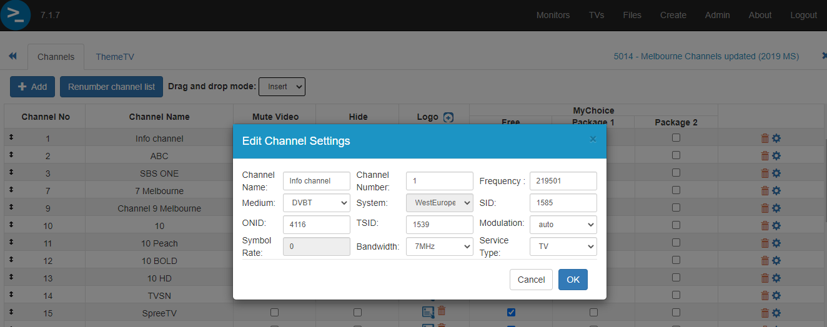
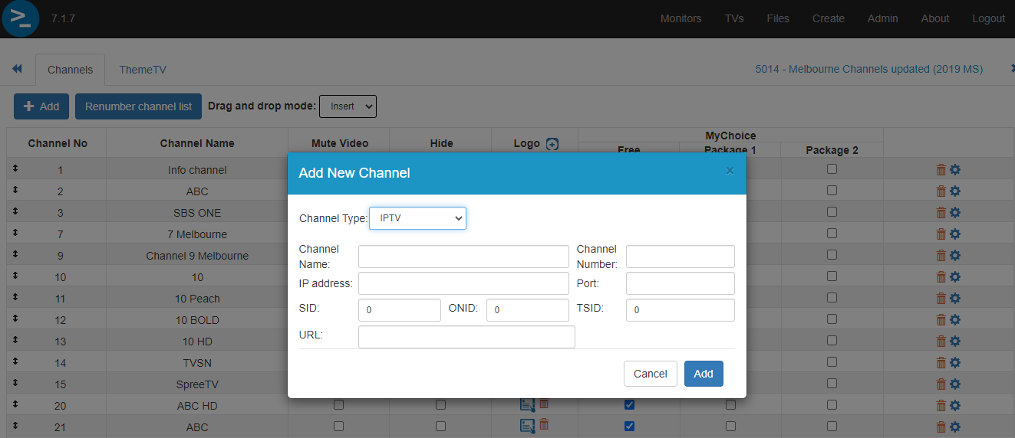
Using CMND – Upload and modify a clone
For more detailed channel edits:
Edit an existing channel’s settings
Manually add a new channel (IP/RF/Media/etc)

Slide 26
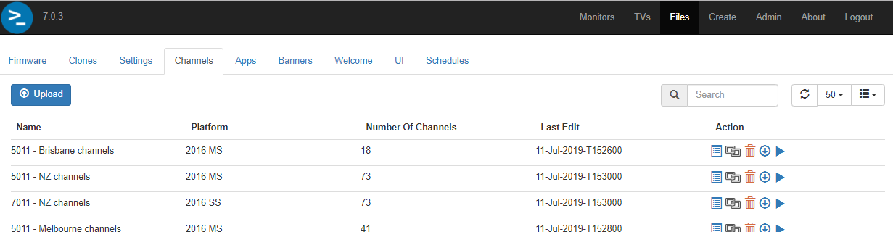
Using CMND – Upload and modify a clone
Channels Packages
You can also view all channel packages that have been created when uploading a new clone
Go to Channels tab
To edit a channels package, select the Channels icon
Can also rename a package from here

Slide 27
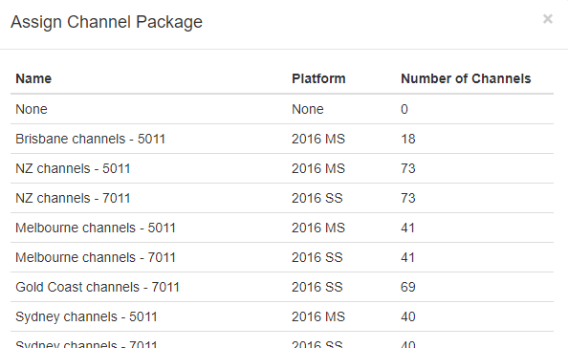
Using CMND – Upload and modify a clone
To assign a channel package to a clone:
Select the checkbox next to the clone
Select “Assign”, then Channels
Choose the desired channel package from the popup list
Packages can only be assigned to a clone file which is based on the same platform the original package was created from

Slide 28
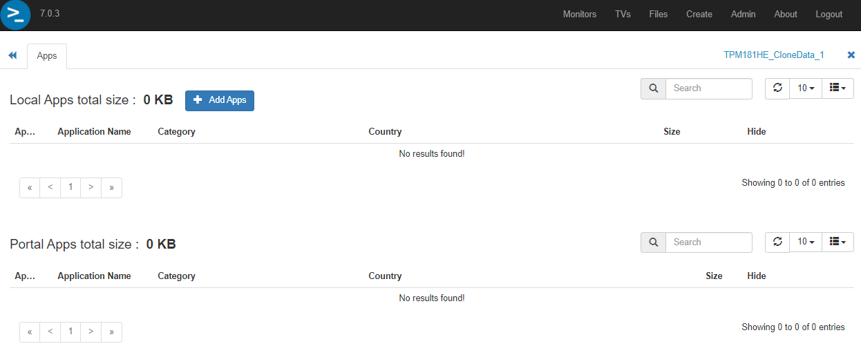
Using CMND – Upload and modify a clone
To edit apps of a clone:
Select the Apps icon in the clone list

Slide 29
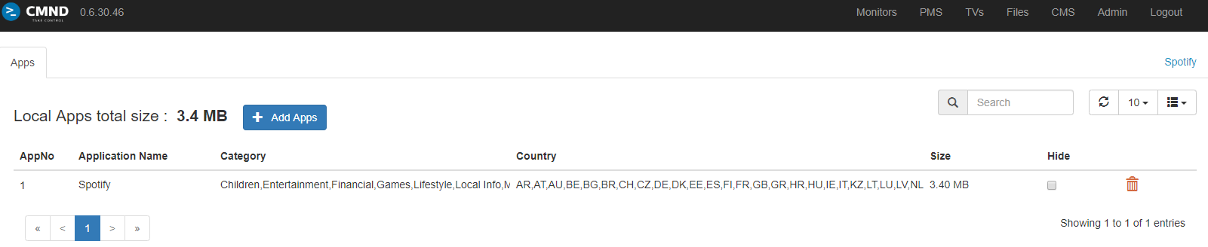
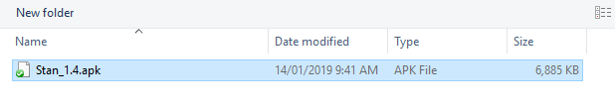
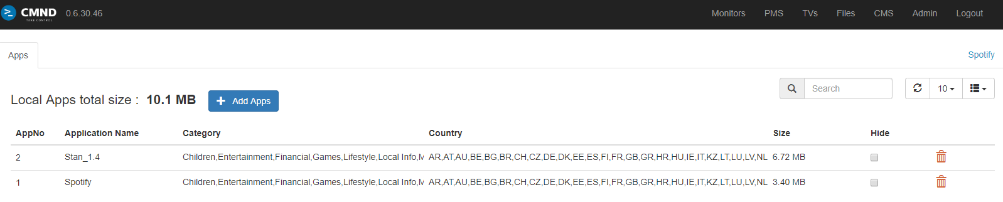
Using CMND – Upload and modify a clone
Custom apps or apps downloaded from apk mirror sites (apkpure.com, apkmirror.com, etc) can be can be uploaded using CMND
Select “Add Apps” to browse your system for the downloaded apk and add it to the app package
Left click AppNo to edit and modify the order Apps will be listed on the TV
Select “Hide” checkbox to install apps but make them invisible to guests
Play Store apps can also be installed on x014 platform TVs (process not covered here)

Slide 30
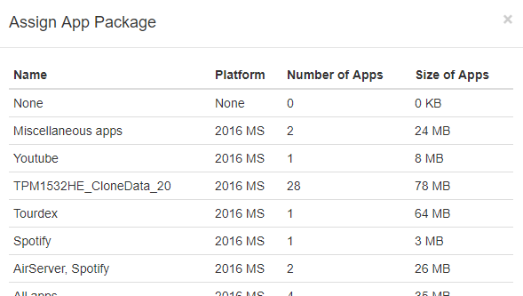
Using CMND – Upload and modify a clone
To assign an app package to a clone:
Select the checkbox next to the clone
Select “Assign”, then Apps
Choose the desired app package from the popup list
Packages can only be assigned to a clone file which is based on the same platform the original package was created from

Slide 31
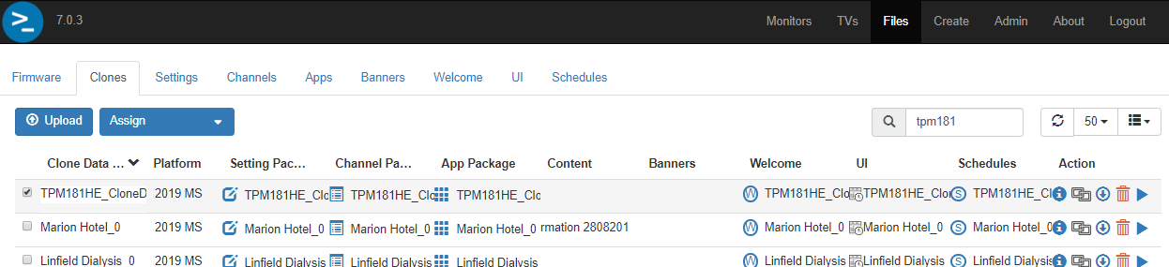
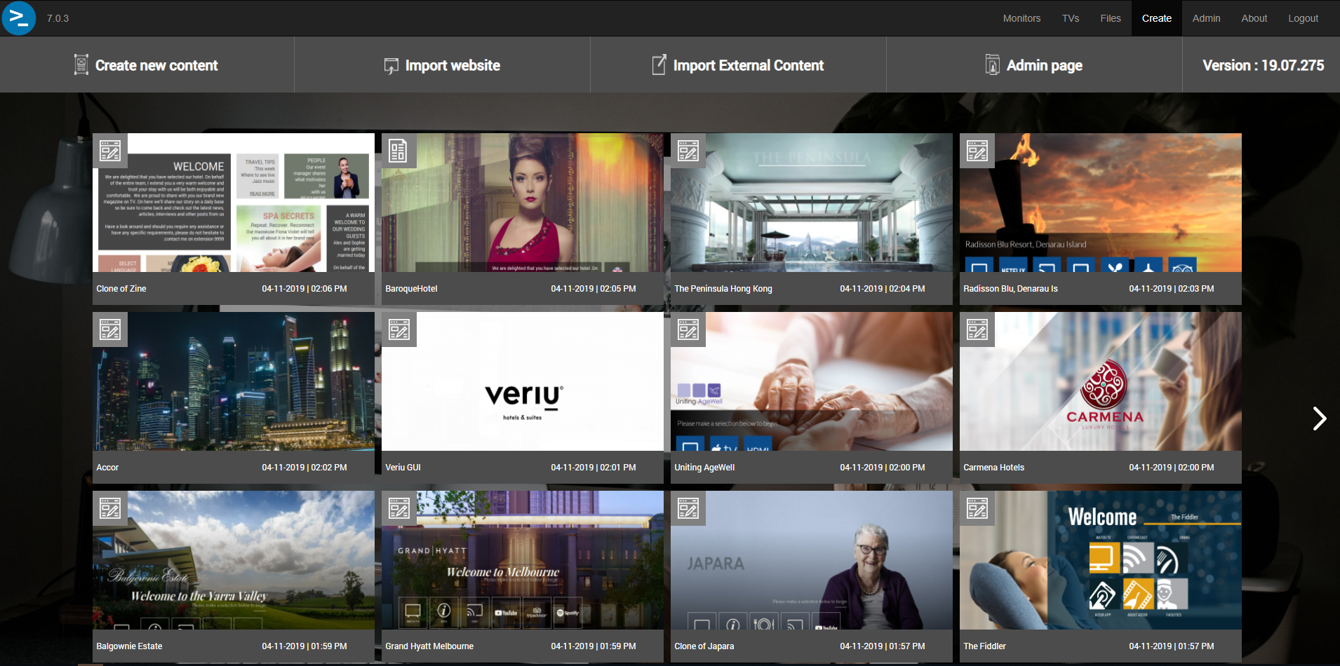
Using CMND – Upload and modify a clone
Content
Content is created in the Create area
Select Create to view the collection of “websites’ in CMND

Slide 32
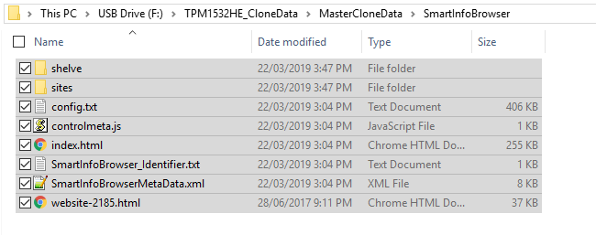
Using CMND – Upload and modify a clone
To add a website to the list:
“Create new content”
“Import website”
From an existing clone
Content in clone folder (SmartInfoBrowser) must be zipped before importing

Slide 33
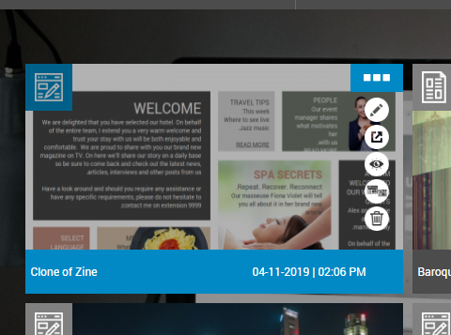
Using CMND – Upload and modify a clone
Hover mouse over a website in the list for actions:
Edit website
Export website (as zip)
Preview website
Clone website and open in editor
Delete website

Slide 34
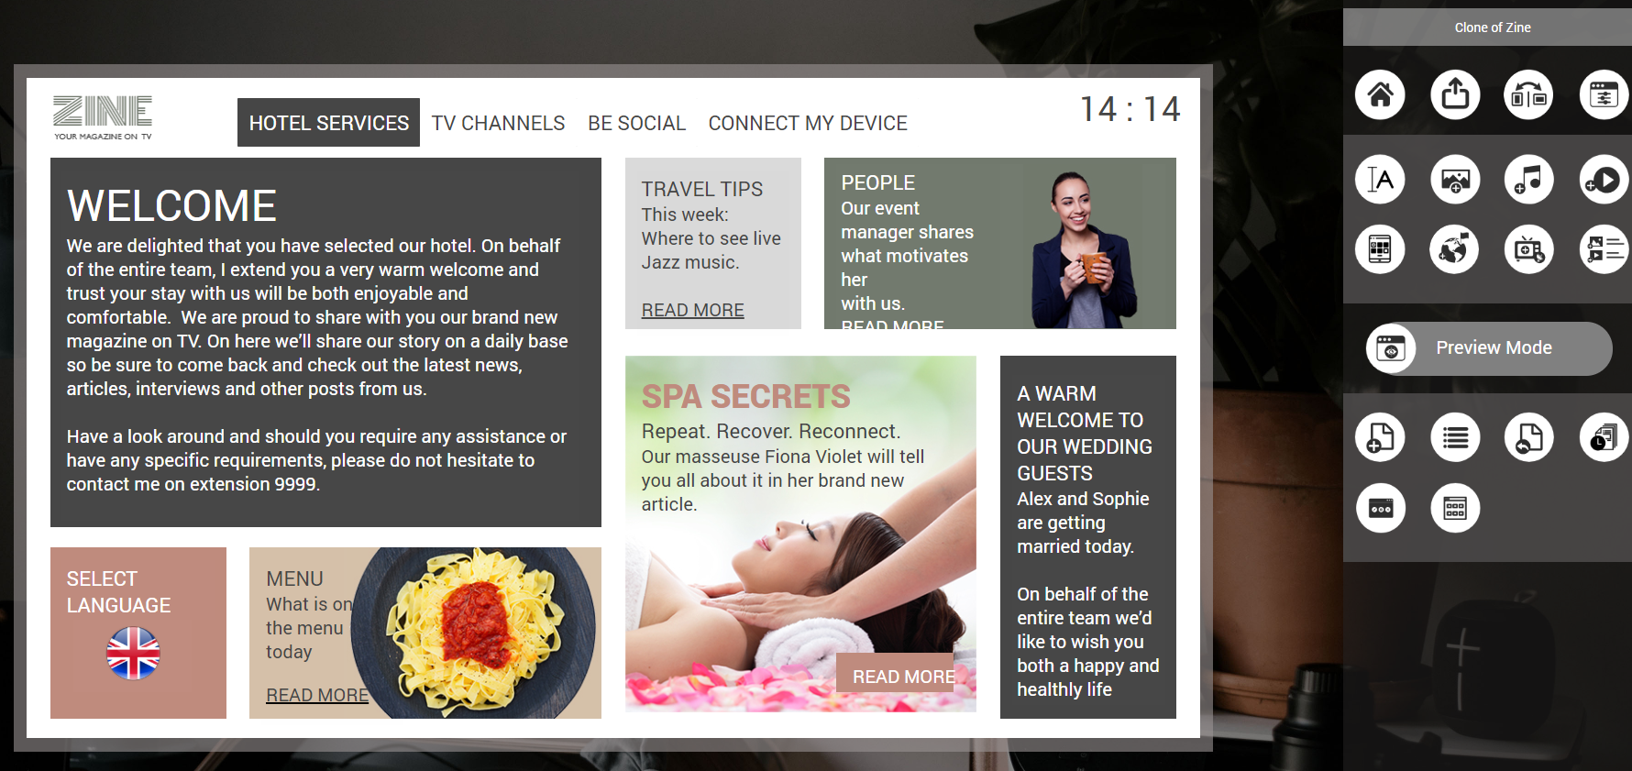
Using CMND – Upload and modify a clone
Editing a website
Canvas (representing the screen)
Management controls
Widgets (to drag and drop on canvas)
Preview control
Page controls
2
1
3
4
5

Slide 35
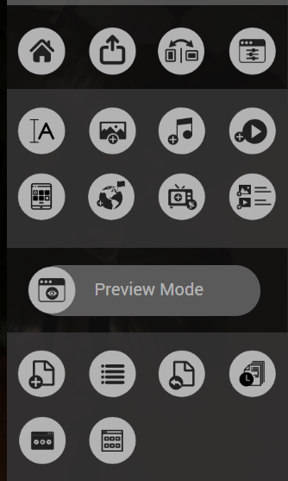
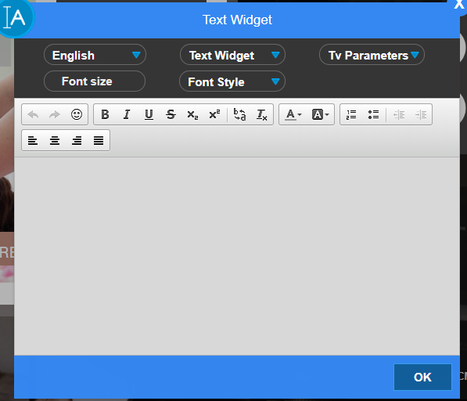
Using CMND – Upload and modify a clone
Build your website by dragging and dropping widgets onto the canvas:
Text

Slide 36
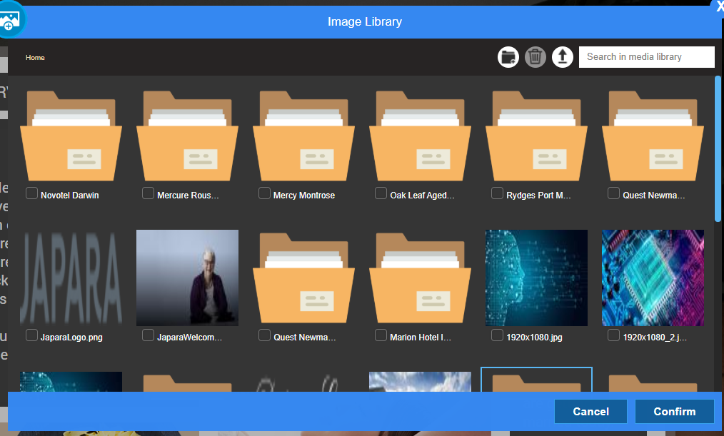
Using CMND – Upload and modify a clone
Build the website by dragging and dropping widgets onto the canvas:
Images
Upload your own content to CMND’s gallery
Or re-use existing content

Slide 37
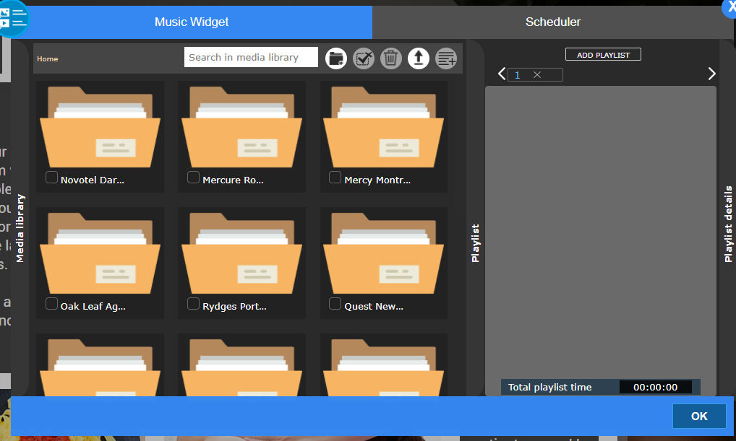
Using CMND – Upload and modify a clone
Build the website by dragging and dropping widgets onto the canvas:
BG Music
Upload your own content to CMND’s gallery
Or re-use existing content
Select multiple items and add to a playlist

Slide 38
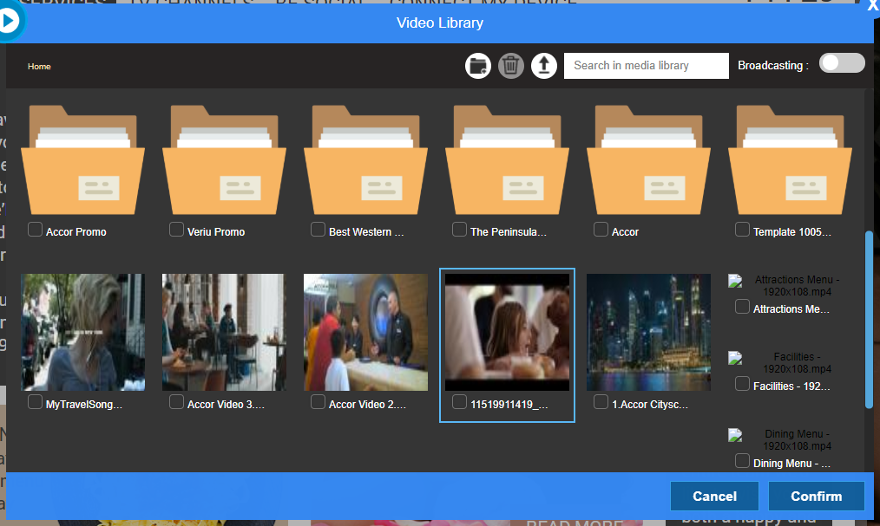
Using CMND – Upload and modify a clone
Build the website by dragging and dropping widgets onto the canvas:
Videos
Upload your own content to CMND’s gallery
Or re-use existing content

Slide 39

Using CMND – Upload and modify a clone
Build the website by dragging and dropping widgets onto the canvas:
Playlist
Upload your own content to CMND’s gallery
Or re-use existing content
Select multiple items and add to a playlist to create slideshow

Slide 40
Using CMND – Upload and modify a clone
Other controls
Preview website
Page scheduler
Add new (blank) page
(Menu bar is added to canvas by default)
Import page from another website

Slide 41

Using CMND – Upload and modify a clone
Page Overview
Reorder pages
Copy/clone page
Import subpage
Add subpage
Delete page

Slide 42


Using CMND – Upload and modify a clone
Actions
Hover over a widget, select the settings icon and go to the Actions tab
Assigning actions to widgets makes them “selectable” by a guest.
Actions can include:
Browse to other pages in website
Switch TV to a channel
Switch TV to a source
Launch a TV feature or app
etc

Slide 43

Using CMND – Upload and modify a clone
When you have finished the website design, to prepare for assigning content to a clone:
Select “Publish” first
Then return “Home” to the website list

Slide 44

Using CMND – Upload and modify a clone
To assign content to a clone:
Select the checkbox next to the clone
Select “Assign”, then Content
Choose the desired content from the popup list
Only websites that have been published in the CMS editor will be visible in this popup list

Slide 45


Using CMND – Upload and modify a clone
Ensure SmartInfo settings are changed on clone to enable the SmartInfo feature on boot:
SmartInfo Mode: BROWSER
Switch On Feature: SMARTINFO

Slide 46


Using CMND – Push out a clone file to TVs
Return to the TVs list
Select one or several TVs you want to clone
Select “Assign”, then “None” even if it was already selected
Then select “Clone” and choose your clone from the pop up box that you want to push out

Slide 47

Using CMND – Push out a clone file to TVs
It is possible to push out a partial clone.
Select the part of the clone you want to push out from the drop down list after clicking “Assign”

Slide 48
Using CMND – Push out a clone file to TVs
The selected clone will be assigned to a TV if it is different to what’s currently on TV, as reported in the TV list.
Cloning will automatically happen 5-10 minutes after TV is in standby. TVs also check for updates ~4am each day. Cloning can take 5-20 minutes per TV.
BLUE – indicates new data is detected and ready to be updated at next opportunity
ORANGE – Update is in progress
GREEN – Update complete

Slide 49



Using CMND – Push out a clone file to TVs
You can force an immediate upgrade by selecting the upgrade button
NB: After cloning a restart of the TV is generally required to avoid unexpected behaviour.
Use the reboot feature to do this
NB: This should only be done when TV is
not in use so as not to disturb guests

Slide 50
Q&A
Questions?

